Slide 1
TRANSMITTERS
Mrs. Meera Ajit Khandekar Department of Instrumentation & Control College of Engineering, Pune

Slide 2
Objective
Control room
Field area
Standard signals
Signal conditioning
Two wire transmitter
Differential Pressure Transmitter
SMART transmitter
Converter

Slide 3
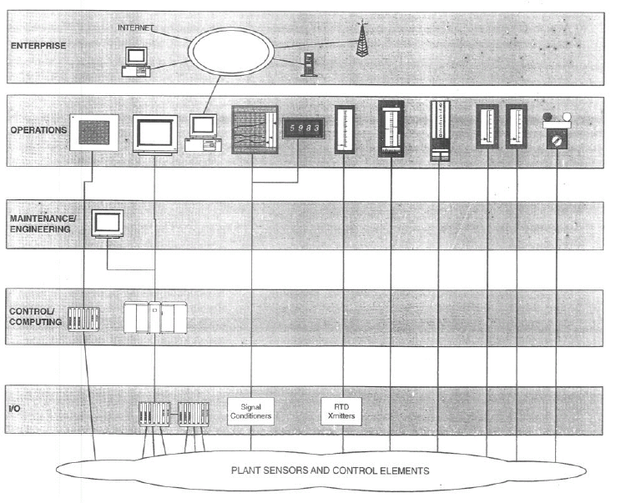
Instrumentation and control architecture

Slide 4
Thousand number of sensor and control elements are used in large process plant.
I/O layer systems that use main frame plant process computer.
Maintenance layer represent any interface made available to maintenance and engineering.
Operation layer represents the device used by the plant operator. These devices include trend recorders, digital indicator, annunciator
The enterprise layer illustrates the basic plant or company enterprise where information technology systems are deployed.

Slide 5
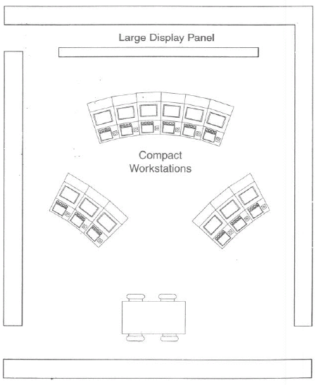
Control Room

Slide 6
Analog Vs Digital
Display
Analog: speed, parallax error
Digital: resolution, instrument error
Hybrid display

Slide 7
Pneumatic signal
Electrical signal or spark could ignite combustible material
Inflexible, bulky, and costly compared to electrical signal lines
Require an excessively long settling time
Pneumatic transmission pressures were standardized into two ranges, i.e., 3 to 15 psi (20 to 100 kPa) and 6 to 30 psi (40 to 200 kPa)
Zero is not used for the minimum of the ranges as low pressures do not transmit well
Zero level can then be used to detect system failure.

Slide 8
Voltage signal
Error in measurement-cable will drop small amount of voltage
Transmitter low output impedance
Internal resistance R of the controller must be very high
Voltage signals are used in many application because of their design simplicity.
Common standard voltage signal 0-10 volts, 1-5 volts

Slide 9
Voltage transmission drawback
Transmitting voltages over long distances produces correspondingly lower voltages at the receiving end due to wiring and interconnect resistances
High-impedance instruments can be sensitive to noise pickup since the lengthy signal-carrying wires often run in close proximity to other electrically noisy system wiring
Shielded wires can be used to minimize noise pickup, but their high cost may be prohibitive when long distances are involved.

Slide 10
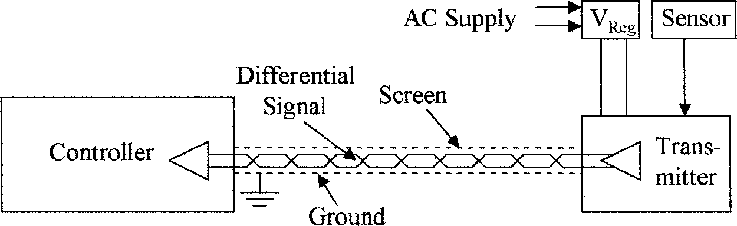
Supply and signal connections are shown between
controller and transmitter using a twisted pair

Slide 11

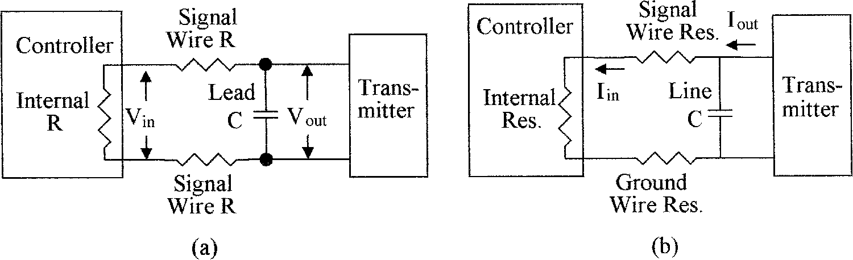
Voltage Signal Transmission
Current Signal Transmission

Slide 12
Current Signal
Standardized signal ranges: 4 to 20 mA and 10 to 50 mA, where 0 mA is a fault condition
Transmitter- high output impedance, so that the output current does not vary with load, temperature, offset drift, and low noise
Controller- internal resistance is low for current signals, i.e., a few hundred ohms

Slide 13
Analog Signal Conditioning
Signal level change
Linearization
Conversion
Signal transmission
Digital interface
Filtering and impedance matching

Slide 14
Divider circuit
Bridge circuit
Lead compensation
RC filters
Operational amplifiers
SCR
TRIAC
DIAC

Slide 15
Guidelines for analog signal conditioning design
Define the measurement objective
Select a sensor
Design the analog signal conditioning
If the input is a resistance change and a bridge or divider must be used, be sure to consider the effect of output voltage nonlinearity with resistance and the effect of current through the resistive sensor
Always consider any possible loading of voltage sources by the signal conditioning

Slide 16
Digital signal conditioning
Digital electronic
Comparator
Hysteresis comparator
Digital-to-Analog convertor
Analog-to-Digital convertor

Slide 17
Linear instruments Calibration: The simplest calibration procedure for a linear instrument is the so-called zero-and-span method The method is as follows: 1. Apply the lower-range value stimulus to the instrument, wait for it to stabilize 2. Move the “zero” adjustment until the instrument registers accurately at this point 3. Apply the upper-range value stimulus to the instrument, wait for it to stabilize 4. Move the “span” adjustment until the instrument registers accurately at this point 5. Repeat steps 1 through 4 as necessary to achieve good accuracy at both ends of the range

Slide 18
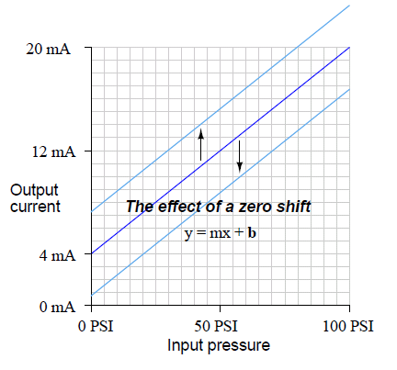
A zero shift calibration error shifts the function vertically on the graph. This error affects all calibration points equally, creating the same percentage of error across the entire range

Slide 19
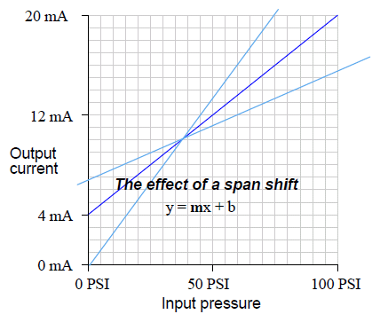
A span shift calibration error shifts the slope of the function. This error’s effect is unequal at different points throughout the range:

Slide 20
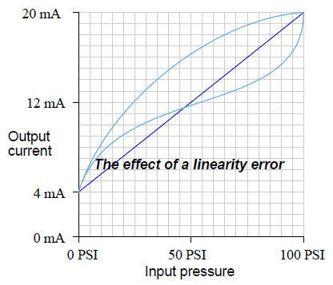
A linearity calibration error causes the function to deviate from a straight line. This type of error does not directly relate to a shift in either zero (b) or span (m) because the slope-intercept equation only describes straight lines. If an instrument does not provide a linearity adjustment, the best you can do for this type of error is “split the error” between high and low extremes, so the maximum absolute error at any point in the range is minimized:

Slide 21
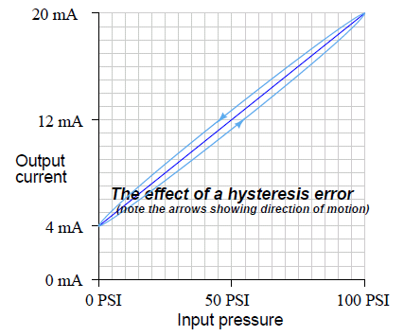
A hysteresis calibration error occurs when the instrument responds differently to an increasing input compared to a decreasing input. The only way to detect this type of error is to do an up-down calibration test, checking for instrument response at the same calibration points going down as going up

Slide 22
What makes 4-20mA signal transmission so attractive?
The accuracy of the signal is not affected by the voltage drop in the interconnecting wiring, which will always have an associated signal loss related voltage signal. This allows the signal transmission to occur over long distances.
The 4mA “Zero-Offset”, “Live Zero”, or “Positive-Zero” is Failsafe
A “Live Zero” of 4mA also permits the two-wire current loop to power the transmitter, simplifying installation and reducing costs
current loop’s low sensitivity to electrical noise : low impedance system, it is much less sensitive to induced noise, than perhaps the high impedance input of a voltage amplifier

Slide 23
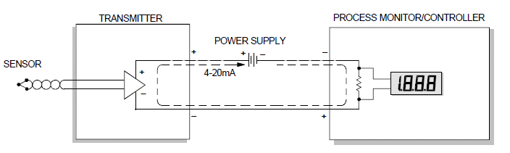

Slide 24
Current loop component
Sensor/transducer: Convert physical parameter(RTD, T/C, Orifice with differencial cell )
Signal Conditioning: voltage-to-current converter etc.
Power Supply: +24V
Receiver: Monitor, Data acquisition system, Recorders, Controller, DMM

Slide 25
Loop Drop
One of a process monitor’s most important specifications—be it a loop-powered or locally powered device—is the total resistance (or “burden”) it presents to the transmitter’s output driver.
Most transmitter’s data sheets specify the maximum loop resistance the transmitter can drive while still providing a full-scale 20mA output
Every component through which the 4-20mA loop current passes develops a maximum voltage drop equal to that component’s resistance multiplied by 0.020 Amperes (20mA)

Slide 26
Transmitter Ratings
Transmitters usually state both minimum and maximum operating voltages
The minimum voltage is that which is required to ensure proper transmitter operation
maximum voltage is determined by its maximum rated power-dissipation, as well as by its semiconductors’ breakdown ratings
A transmitter’s power dissipation can be determined by multiplying its loop drop by the highest anticipated output current
if a transmitter drops 30V at an over range output level of 30mA, its power dissipation is:
For example
30V x 0.030A = 0.9 watts

Slide 27
Wiring resistance
If a transmitter’s output is delivered to a remote process monitor using 2000 feet (660 meters) of 26-guage, solid copper wire having a resistance of 40.8ohm per 1000 feet, the one-way voltage dropped by the wire when the transmitter’s output is 20mA is equal to:
E = 0.020 Amperes x [2000 feet x (40.8 ohm /1000 feet)] E = 0.020A x 81.6 ohm = 1.63V
The total voltage dropped over the 4000 feet of wiring is therefore=3.27V

Slide 28
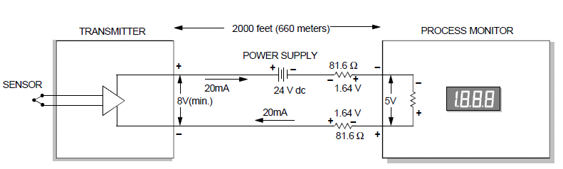

Slide 29
Power supply
It must be set to a level that is greater than the sum of the minimum voltage required to operate the Transmitter, plus the IR drop in the Receiver, and for long transmission distances, the IR drop in the wire

Slide 30
ANSI/ISA standard 50.00.01 actually describes three different current loop connection types
The two-wire transmitter described here is a Type 2 connection type, in which the transmitter has a “floating” connection relative to ground
Type 3 connection type, or 3-wire transmitter loop, where the Transmitter and Receiver share a ground connection with power, and the transmitter uses a third wire to connect to power outside of the current loop

Slide 31
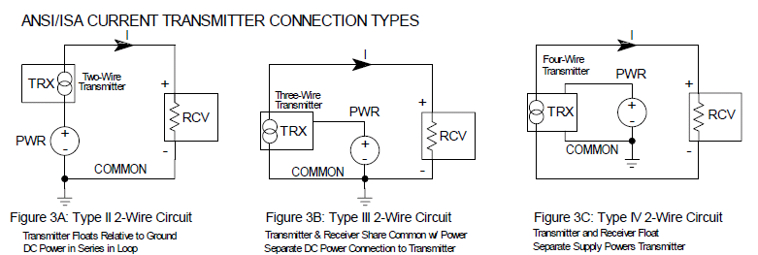
Type 4 refers to a 4-wire transmitter where the transmitter and Receiver float, and separate power leads power the transmitter outside of the current loop

Slide 32
The obvious disadvantage of 4-wire scheme is the requirement of two more conductors in the cable
Cables with more conductors will require larger electrical conduit to fit in to, and all field wiring panels will have to contain more terminal blocks to marshal the additional conductors
A 2-wire transmitter’s circuitry is designed to act as a current regulator, limiting current in the series loop to a value representing the process measurement
The current “source” in 2-wire loop-powered transmitter actually behaves as an electrical load
The current source in the 4-wire transmitter functions as a true electrical source

Slide 33
A flow transmitter is ranged 0 to 350 gallons per minute, 4-20 mA output, direct-responding. Calculate the current signal value at a flow rate of 204 GPM
First, we convert the flow value of 204 GPM into a percentage of range. This is a simple matter of division, since the flow measurement range is zero-based:
204 GPM/350 GPM = 0.583 = 58.3%
Next, we take this percentage value and translate it into a milliamp value using the formula
previously shown:
(16 mA)( x/100%)+ (4 mA) = current
(16 mA)(58.3%/100%) + (4 mA) = 13.3 mA
Therefore, the transmitter should output a PV signal of 13.3 mA at a flow rate of 204 GPM

Slide 34
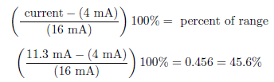

A pH transmitter has a calibrated range of 4 pH to 10 pH, with a 4-20 mA output signal. Calculate the pH sensed by the transmitter if its output signal is 11.3 mA

Slide 35
Thank You

